Slide 1
Survey analysis week 39 Simple Random Sampling
© Peter Lugtig

Slide 2
The big picture
Inference
use a small dataset to say something about the world
Design based:
probability based sampling and inferenc
Estimate and correct for each TSE source
Weeks 39-~47
Model-based
Big data, any data?
Model all the data errors, but how?
Week 44-~50

Slide 3

Class exercise
Deck of 52 cards
Spades, diamonds, clubs, hearts
Each suit: 13 cards
How many cards of Spades?
When sample of size 10/40
When drawing with/without replacement
Your results

Slide 4
The sampling distribution
See file “simulation cards srs.R”
Lets repeat the experiment 10.000 times!

Slide 5
Simple Random Sampling
Every element on the sampling frame has an equal, non-zero probability of being selected into sample
Element: individuals/households/companies
Population: collection of elements
Why/when use a SRS?

Slide 6
Simple random sampling: when?
There is a sampling frame consisting of population elements
Bonus Q: what to do if we have no frame?
No need for clustering
Depends on mode
Web/mail vs. face-to-face/telephone
No need for stratification
Little is known about people on sampling frame
Known characteristics do not correlate with dependent variables

Slide 7
Sampling with/without replacement
When does it not matter?
Selecting 1 out of 52 cards

Slide 8
Sampling without replacement (SRSWOR)
When does with/without not matter?
Selecting 1 out of 52 cards
What happens when we select 2 cards WOR
Card 1:
13/52 chance for Spades
Card 2:
75% chance for 13/51
25% chance for 12/51
Expected value for 2 cards:
0.25 + (.75*13/51+.25*12/51)=
0.25 + .1912 + .0588 = .50 Spades

Slide 9
Sampling with replacement (SRSWR)
When does it not matter?
Selecting 1 out of 52 cards
What happens when we select 2 cards WR
Card 1:
13/52 chance for Spades
Card 2:
13/52
Expected value for 2 cards:
0.25 + 0.25 = 0.50
SRS(WR) and SRSWOR are both unbiased estimators of population mean
Also of mode/median (the beauty of the central limit theorem)
We assume no other errors (coverage, nonresponse)

Slide 10
So what’s the fuss – variance of estimator
Extreme case: select 52 of 52 cards
Expected value: 13 Spades in both
Variance SRSWOR estimator: 0
Repeating it a 1000 times -> always 13 spades
This method needs correction -> without it is biased
Variance SRS(WR) estimator: 9.48
Repeating it a 1000 times -> variation
Difference in variance is larger when a larger proportion of population is sampled

Slide 11
Estimators
If we repeat a study n times (say 1000), we can investigate:
Bias: is the mean/variance/etc. correctly estimated in the long run?
Do we get p=.25 for spades on average?
Variance of estimator (precision)
How much variation is there in the mean?
In reality we take just 1 sample!
Consistent: does it work across all situations?
Different kinds of data
Mean Square Error = bias² + variance

Slide 12
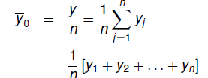
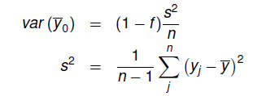
Computation SRSWOR (without)
Mean under Simple Random Sampling
Variance of the SRS mean estimate
Correction 1: fpc
Correction 2: Divide by n-1

Slide 13
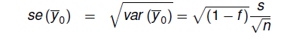
How do we compute s.e.?
Mean under Simple Random Sampling (SRS):
Variance of the SRS mean estimate:
S.e. of the SRS mean estimate:
n = sample size, s=standard deviation in sample

Slide 14
Intermezzo 1: Fpc in practice
Fpc = (1-n/N) or (N-n)/N
Sampling is done without replacement
fpc approaches 1 when n/N small
when sample of 1.000 people in the Netherlands is drawn:
Fpc = 1 – 1.000/17.000.000 = 1 – 0,00058 = 0,99942
When sampling fraction n/N < .05, ignore FPC
We assume a infinite population

Slide 15
Intermezzo 2: (n-1) or n?
Bessel’s correction for variance: Divide by n-1 when you calculate variances (or s.e.) using sample data
Why?
Ideal:
In practice:
The sample mean is always a bit biased
the sum of squares is smaller than it should be
Divide by n-1 in denominator to adjust
µ)²

Slide 16
Why smaller?
Sum of squares is too small when using a sample
Why? Here is what we would like
Divide by n-1 in denominator to adjust
dividing by n-1 works for variance, but biased for s! (sqrt(s²))
When you would resample many times
Not the smallest MSE with many types of data
often sqrt(1.5) used instead of n-1 in larger samples
Just remember: use n-1 for variance estimate of mean
Want to know more? See “bessels correction.r” on Blackboard
((y_{j} - y) + (y- µ))²

Slide 17
Computation SRSWR (with)
Mean under Simple Random Sampling
Variance of the SRS mean estimate
Same as without replacement
No fpc
Notes:
Check formula under 2.

Slide 18

A real example
I would like to do a survey among all students at Utrecht University
Population = 20.000
RQ: Interested in differences in grades and student happiness between programmes
approx. 49 BA programmes and 150 MA programmes
Limited budget (cannot do census) for about n=1000
5 minutes: how do we
do this?

Slide 19
Example: possible solution
Cheap: e-mail
Can do complicated stratification to ensure enough students from every programme
200 + programmes…
Simple random sampling (SRS)
Risk of small n for some programmes.
Let’s work out how SRS works
And talk about sample size

Slide 20
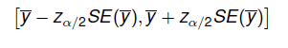
Why is standard error useful?
Gives indication of both
Uncertainty due to sampling error
Uncertainty in estimation (e.g. ML estimation)
Used to construct confidence Interval:

Slide 21
How large should my sample be?
#1. question in statistical consultation
Depends on:
Statistic of interest (here: mean)
Variance in sample/population
Required precision of Confidence Interval
Alpha, standard error
Size of sample/population (n/N)
Leads to POWER (beta).

Slide 22
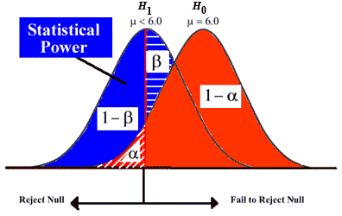
α?β?
Type I error (α) is to reject H0 while H0 is true
Type II error (β) is to accept H0 while H1 is true

Slide 23
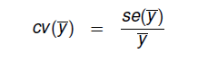
How large should my sample be?
α =.05
Standard error?
Estimate relative error instead
Coefficient of variation

Slide 24
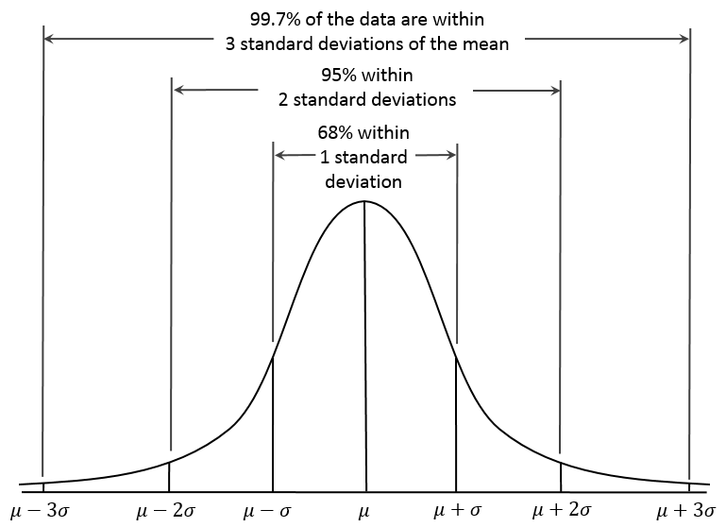
Power and confidence intervals
With alpha=.05
Two-sided test
Z-value for alpha=.05: 1.96
Confidence interval
[-1.96*se, +1.96*se]

Slide 25
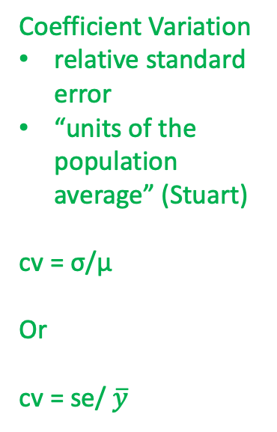
Coefficient of variation
With alpha=.05
Two-sided test
Coefficient Variation
relative standard error
“units of the population average” (Stuart)
cv = σ/μ
Or
cv = se/ $\overline{y}$

Slide 26
Margin of error
With alpha=.05
Two-sided test
Margin of error
(radius of CI)
1.96 * s.e.

Slide 27
Class exercise
What is mean grade of students at Utrecht University (1-10-scale) under SRS?
Population = 20.000 students
Best guesses for means and Variance?
Mean: 7.0
variance: 4
I want to be precise: s.e. restricted to 2% (cv=.02)
Implies CI of [-1.96 *2 ; 1.96*2] = 7.84%, and
Margin of error [1.96*2] = 3.92%
Alpha = .05
How large should sample be?

Slide 28
Solution:
1. standard error:
.02 = x / 7 = .14/7
2. Compute n under SRSWOR:
.14 = sqrt(1-f)* (2/sqrt(n)) #2 = sqrt(4)
2/.14 = sqrt(n)/sqrt(1-f) = 14.286² /sqrt(1-f).
n=204.08 (or 205)
We may ignore fpc because sampling fraction <5%
Or: f = 1-(205/20.000) = 1-.01 = .99
2/.14/(sqrt(.99) = sqrt(n) = 14.43² = 206.14 (or 207)

Slide 29
Same exercise (if you have time)
What if?
Alpha = .005 (the “new”) level proposed by Benjamin et al (2017)
Margin of error = 5%?

Slide 30
Solution alpha = .005? MoE 5%?
1. c.v = .05 /2.58 = .0193
(MoE = ½ CI, Z-value: 2.58)
2. standard error:
.0193 = x / 7. = 0.13566/7
2. Compute n under SRSWOR:
0.13566 = sqrt(1-f)* (2/sqrt(n))
2/0.13566 = sqrt(n)/sqrt(1-f).
N=217.35
We may ignore fpc because sampling fraction <5% (.01)
Otherwise: 2/.1356/sqrt(.99) = sqrt(n) = 14.90² = 219.52 (or 220)
Notes:
Add formula

Slide 31
MoE and sample size

Slide 32
Estimator
Equal selection probabilities (SRS):
Unbiased estimator of mean, variance in population
Also of regression (OLS), other estimates
When there are no coverage and nonresponse errors
Unequal selection probabilities
All formulas shown so far do not work
Next week…

Slide 33
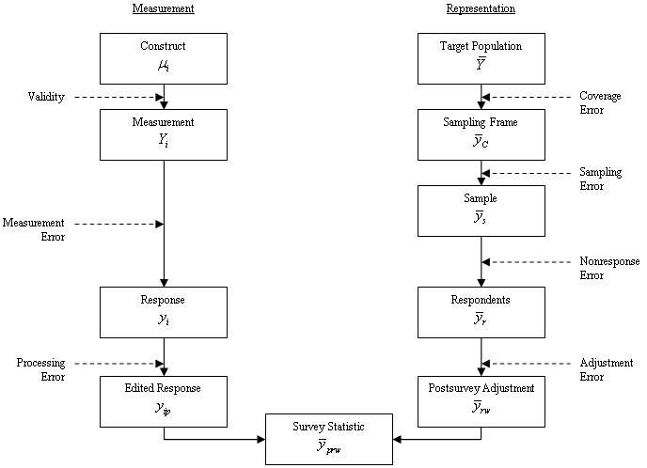
Weights

Slide 34
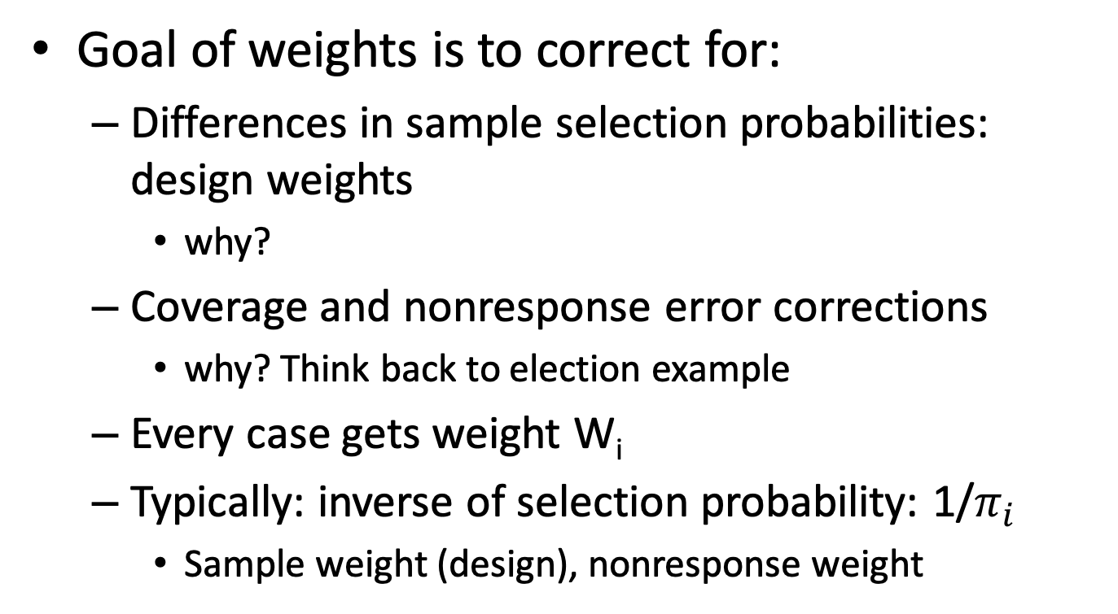
Weights
Goal of weights is to correct for:
Differences in sample selection probabilities: design weights
why?
Coverage and nonresponse error corrections
why? Think back to election example
Every case gets weight W_{i}
Typically: inverse of selection probability: 1/$π_{i}$
Sample weight (design), nonresponse weight

Slide 35
Weights: under SRS
Mean
Under SRS:
W_{i} = N/n, for every i for sample total
W_{i} = 1; for sample estimates
For stratification, clustering:
Corrects bias in means by assigning different weights
Variance: more complex (later weeks)
Variation in weights add to total variance in weighted statistics!

Slide 36
Next week
Take home exercise week 39
Draw SRS samples (once more)
Work with Svydesign (new!)
Work with design weights (new!)
Next week:
We will discuss sampling designs with explicit unequal selection probabilities (stratification and clustering)
Read Stuart

